Slide 1
HUDK4050: Educational Data Mining
Group 4 Midterm Presentation
by Carla Silva Hounshell, Ethan Hiew, Mia Li, and Nicholas Lin

Slide 2
Student Dropout Prediction Challenge
College academic + Personal Information from Fall 2011- Summer 2017 terms
Goal: Create a predictive model of undergraduate dropouts

Slide 3
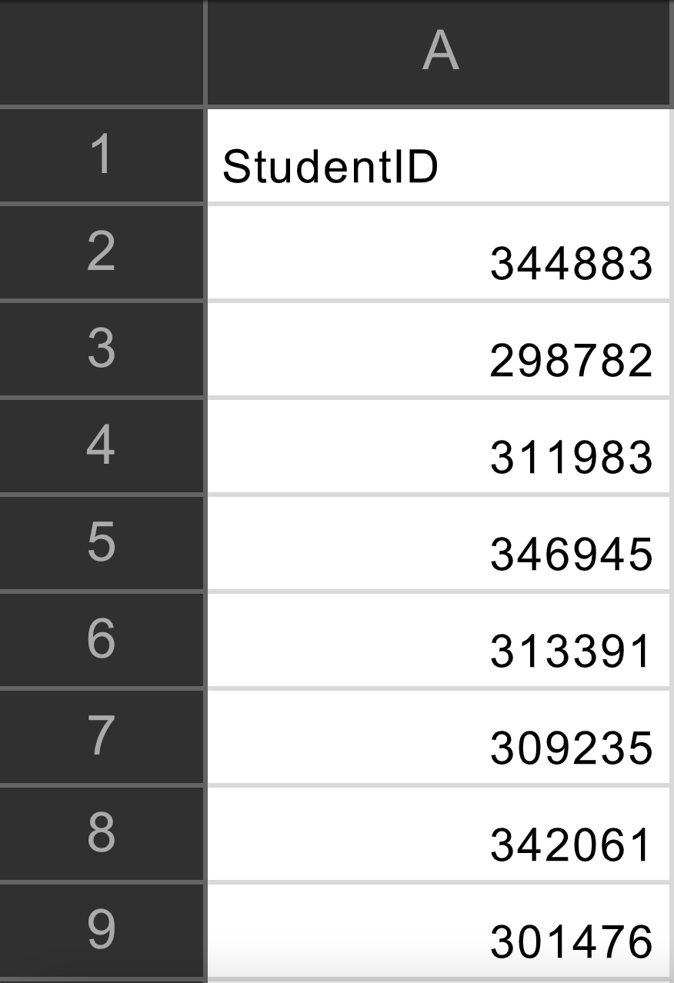
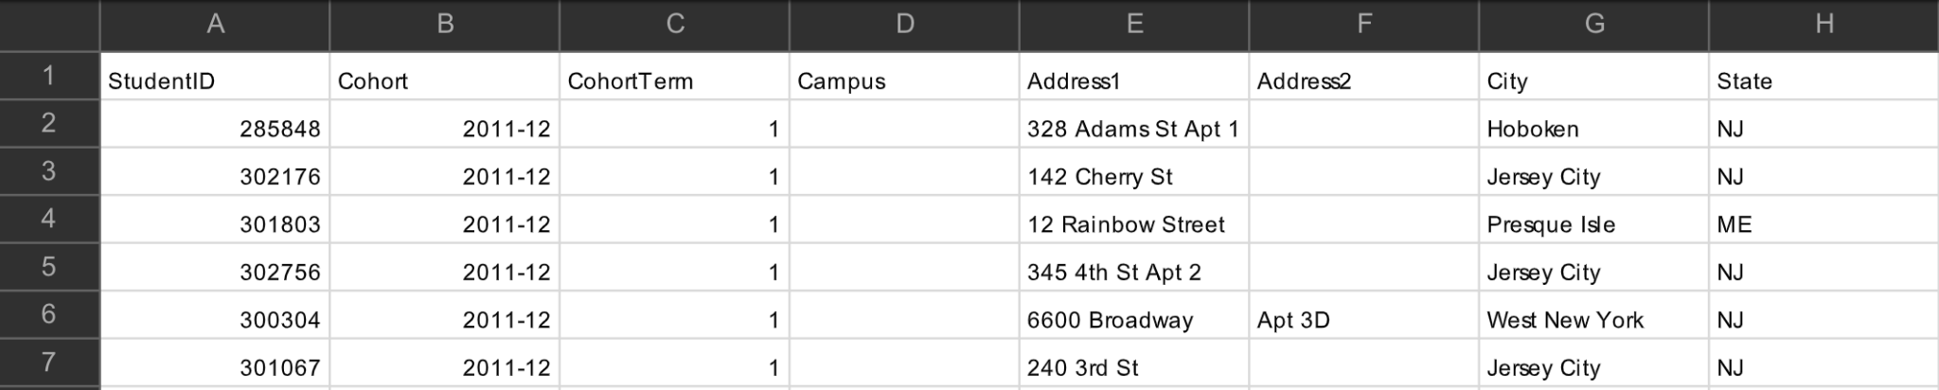
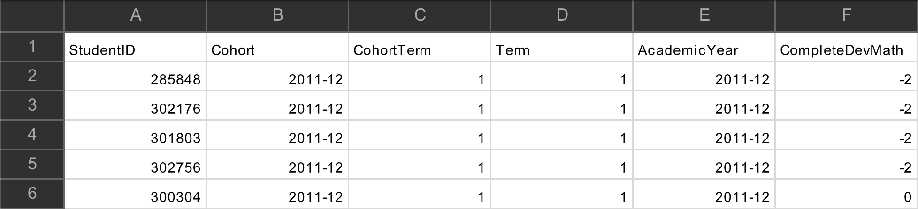
Data Wrangling
We first organized student data within a group directory and then joined each of the datasets into individual DataFrames in Python. The student static and progress data was scattered throughout multiple datasets and this made it so they individually had to be joined before being merged together with the student dropout labels and student financial data. Importantly, since each dataset had to be merged using “StudentID” as a key, this column had to be changed within the financial dataset from “ID with leading” to “StudentID.”

Slide 4
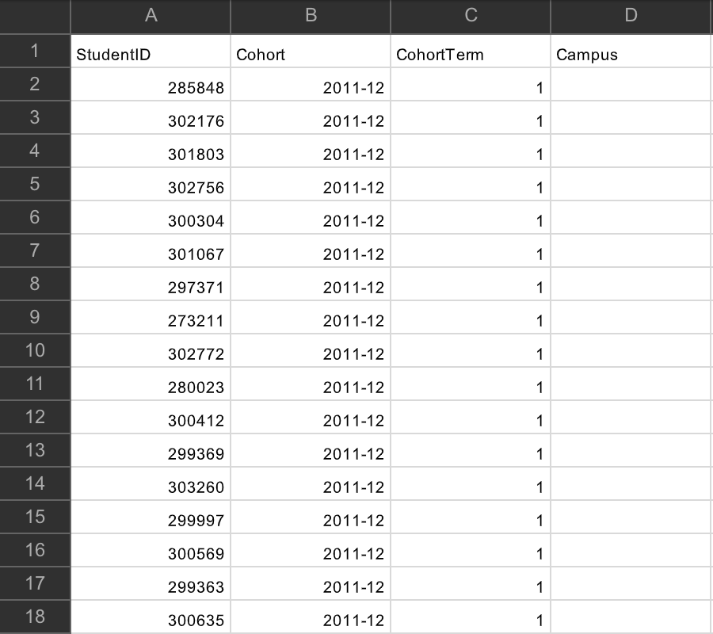
Data Wrangling
From here there were missing values, inconsistent entries, and redundant data throughout the datasets. From here we aimed to involve standardizing entries for uniformity and most importantly only kept records from each student’s last term in order to only consider the most relevant information to predict student retention and dropout rates.

Slide 5
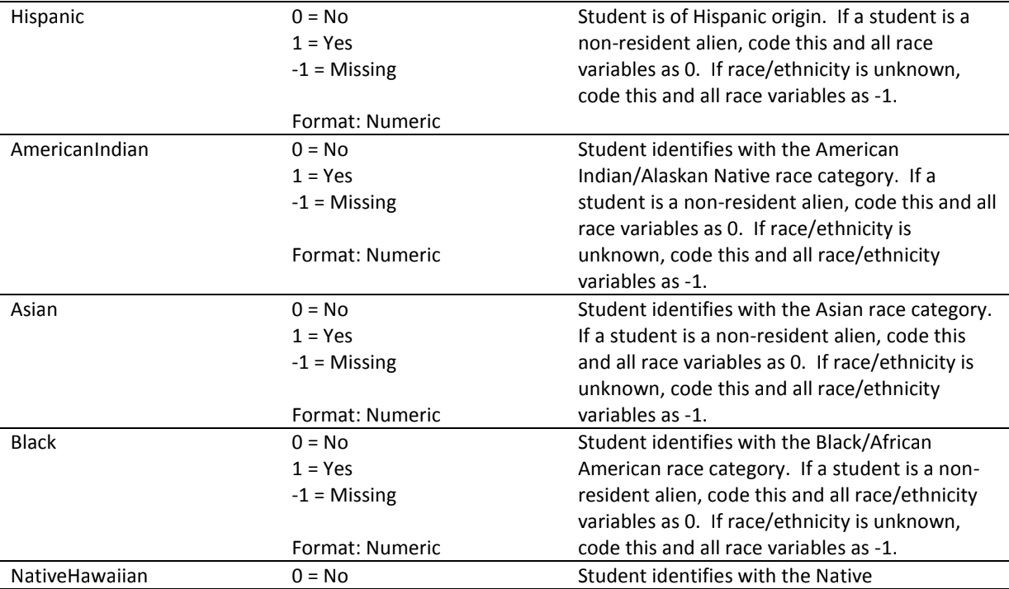
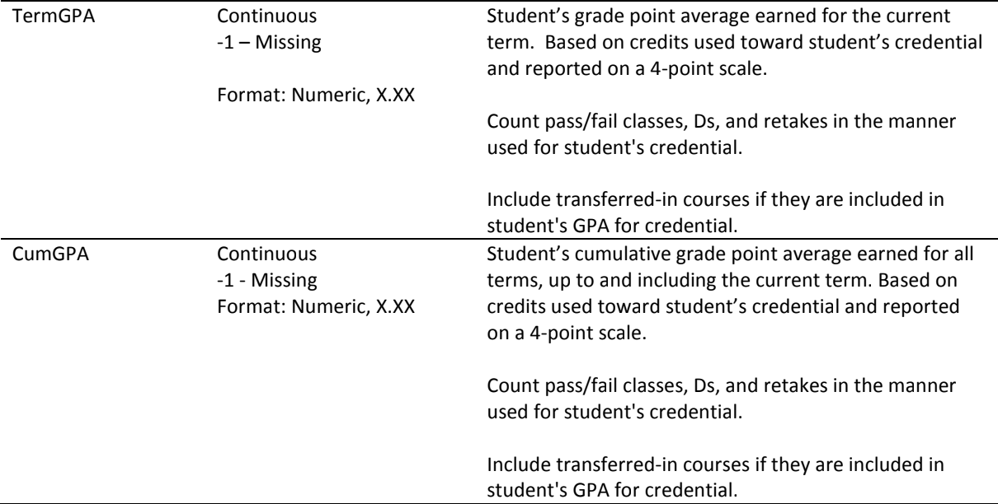
Data Wrangling
Missing values were especially prevalent in the financial as well as student progress datasets. We then used varying imputation techniques in order to impute missing values based on whether the feature was numeric or categorical. Numerical data, such as GPA, were imputed with median values while categorical data, such as the student’s race were substituted with either the mode or placeholders.

Slide 6
Data Wrangling
We now aimed to pre-process the categorical variables we just encoded. We used one-hot encoding for nominal variables and label encoding for ordinal variables. Next we dropped several features from the dataset and first dropped features that were missing more than 60% of values. Demographic information was considered to be removed but was instead one-hot encoded and remained within the dataset and allowed the data to be more streamlined for future model training.

Slide 7
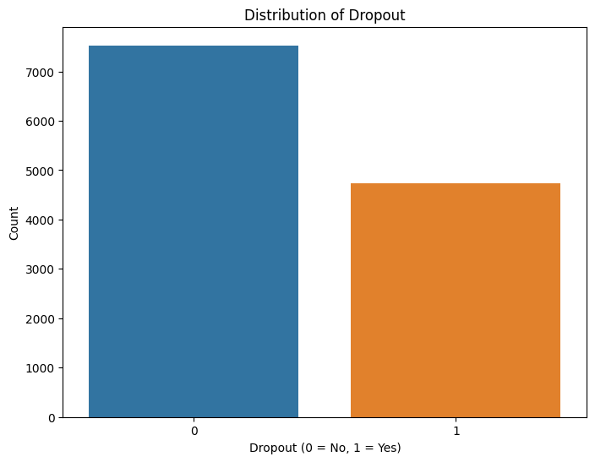
Exploratory Data Analysis
We first explored the balance within the target variable class. This allowed us to understand how skewed, if skewed at all, the results were from the dataset. The degree of class imbalance would allow us to create strategies such as resampling or other performance metrics which are specifically applied to imbalances.

Slide 8
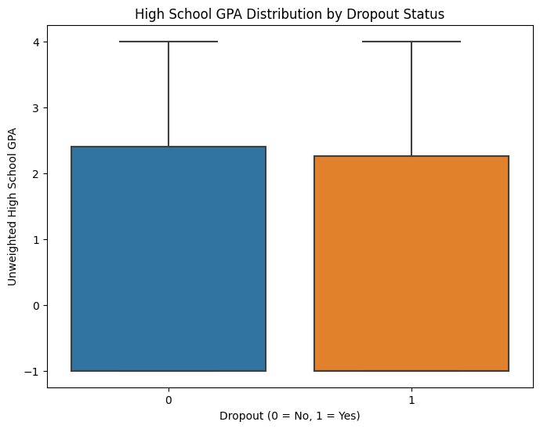
Exploratory Data Analysis
We then explored the distribution of high school GPA among the target class to see how high school GPA could relate to dropout rates. Variation in GPA could indicate that there is an importance in previous academic performance as a predictor for dropout.

Slide 9
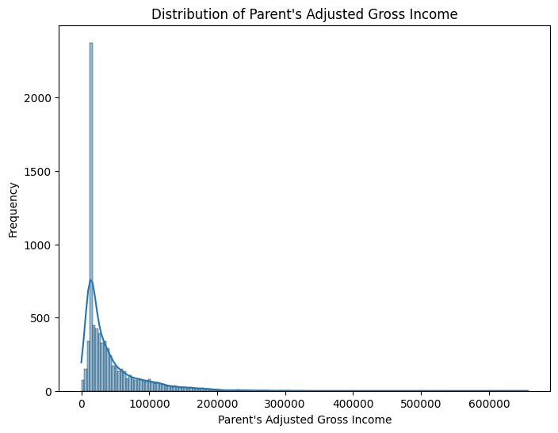
Exploratory Data Analysis
We then analyzed the distribution of parental gross income. This gave us insight to the economic background of each student’s family. This could potentially grant insights into which students of which backgrounds could be more prone to dropout and help to influence feature selection as well as model selection.

Slide 10
Exploratory Data Analysis
Exploratory Data Analysis
Our basic takeaway was that there was a slight imbalance within the target class. However considering other datasets which are frequent encountered in data science applications, such as credit card fraud datasets, this imbalance was quite frankly negligible.
For GPA it seems as if the distribution of high school GPAs were almost identical for students that dropped out and those that didn’t. This was quite surprising and served to help us consider other features that might more accurately capture the relationship between features and the target variable.
Finally for parental income it can be seen that this data is incredibly right-skewed. Of course since it is financial earning data, this is not surprising as income is mostly right-skewed. However there is something to be said that that a large majority of students that dropped out are closest to the bottom end of the spectrum of earning data. Of course as discussed earlier earning data is inherently right-skewed but this could be an interesting relationship to explore.

Slide 11
Feature Engineering
After merging student dropout, static, progress and financial data, feature engineering was crucial in creating a comprehensive profile for each student. Features for each student were first standardized in order to ensure data integrity with special care being taken to address duplicates. Originally the merged dataset had over 50,000 students and by removing the duplicates we ended with exactly 12,261 student profiles. This was done by only including the last term each student attended the school in order to get the most accurate snapshot of a student’s educational profile in that moment.

Slide 12
Feature Engineering
Next missing values were tackled by using tailored imputation strategies based on the type of data which was referenced within the dataset. This allowed us to keep as much educational context behind each feature as possible while still creating a comprehensive dataset that a model could be trained on. Importantly at this important I had realized that it would be feature engineering that would enhance both the model’s training process as well as the predictive power that our model would possess.

Slide 13
Feature Engineering
We actually featured engineered an entire dataset and trained multiple models on the feature engineered dataset. However all of our models had pretty poor performance and therefore we concluded that the best way to proceed was to just approach feature engineering and pre-processing in a different way in order to have more relevant data and features to train models on.

Slide 14
Feature Engineering
Categorical variables being one-hot encoded was especially crucial as standardization was required in order to potentially use the data with a wide breadth of algorithms. Interaction features, and in particular academic performance metrics, were created in order to better understand complex relationships between variables. For financial data, more informative indicators such as ratios were employed in order to better understand role of financial status in dropout risk.

Slide 15
Modeling
Given we aimed to predict student dropout, we implemented a diverse set of machine learning models in order to comprehensive analyze the data and result in the best performance of a machine learning model. We included both individual as well as ensemble machine learning methods in order to complete a comprehensive approach to analyze the data.

Slide 16
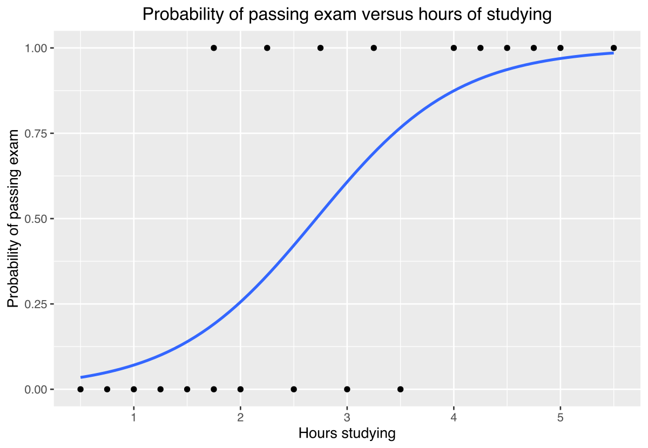
Logistic Regression
Our first choice of a model was a logistic regression model as it is a standard powerful linear model for binary classification tasks. And considering our task was student dropout prediction, logistic regression made sense as the first step. However we ran into issues considering how many features were present within the dataset and this made it so the logistic regression fit very poorly to the dropout label prediction. Although dropout prediction was a binary classification task, logistic regression did not result in the robust performance we sought.

Slide 17
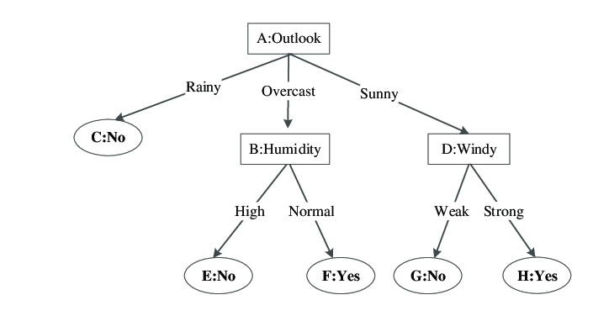
Decision Tree
Decision Trees provide clear interpretation of relationships between features. Most importantly decision trees allow for the capture of non-linear relationships within the data. Usually decision trees have issues with overfitting however in this dataset this was not a pressing issue and we also addressed this by utilizing cross-validation to find the optimal hyperparameters. We found that decision trees performed better than our initial logistic regression but not enough to our standard of deploying a robust model.

Slide 18
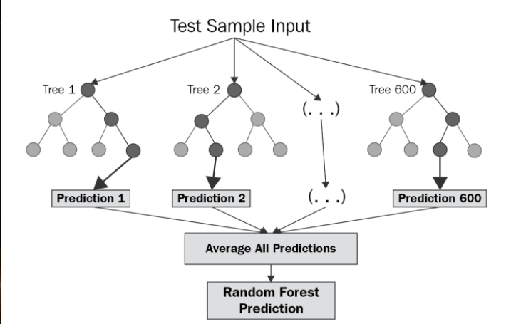
Random Forest
Random Forests are an ensemble of decision trees and because of this we decided to implement this next. Although overfitting wasn’t our primary concern, random forests also serve to prevent overfitting. We used cross-validation in order to determine the best hyperparameters to train our model on and resulted in significantly better performance than the lone decision tree had been able to produce.

Slide 19
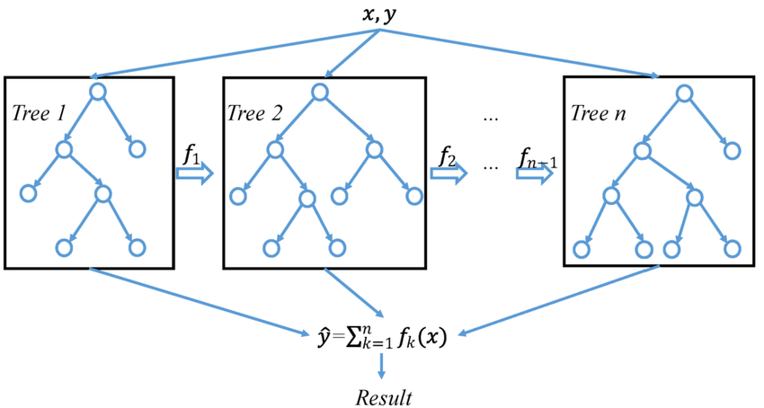
XGBoost Classifier
Our final effort to achieve the highest F-beta score with beta = 2 was by implementing a XGBoost classifier as it is well regarded for high performance, efficiency, as well as customizable hyperparameter tuning. This turned out to be a challenge however as the model’s complexity made it so we had to conduct extensive hyperparameter tuning using GridSearchCV as well as RandomizedSearchCV in order to optimize our model. However this did result in slightly higher performance than our optimized Random Forest classifier so it was a positive development.

Slide 20
Notes about our data modelling experience
Our initial test cases performed extremely poorly given the circumstances. At first this was attributed to low computational power within the first few models but eventually we realized we had to completely re approach how we feature engineered the original student dataset. After doing this model performance increased significantly however it still wasn't up to an adequate standard of model performance. After this we performed hyperparameter tuning to optimize hyperparameters especially for our Random Forest Model and our XGBoost Classifier. This boosted our performance on these models slightly but it didn’t result in the performance we thought it would.

Slide 21
Why this is relevant
Although undergraduate dropout predictive measures are not universally applicable, this can tell us very important information about the associated factors behind why people drop out.
We can look at this data and not necessarily fix it directly, but by minimizing risk factors we can identify weaknesses and improve our education system.

Slide 22
Thank you

